Slide 1
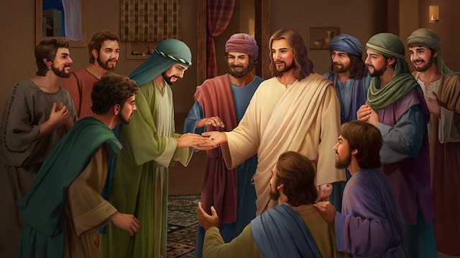
遇见复活的主 Encountering with the Risen Lord 约 /John 20：19-29

Slide 2
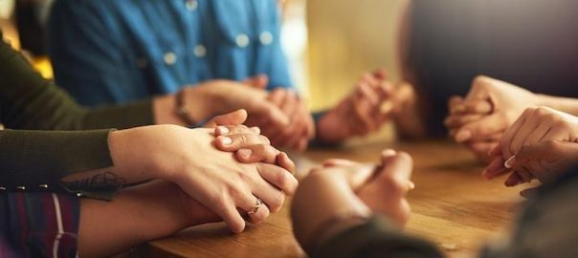
祈祷/Prayer

Slide 3
圣诞节/Christmas 复活节/Easter

Slide 4
一、门徒的疑惑 I. The doubting disciples 我非看见他手上的钉痕，用指头探入那钉痕，又用手探入他的肋旁，我总不信。 Unless I see the nail marks in his hands and put my finger where the nails were, and put my hand into his side, I will not believe. 约/John 20:25

Slide 5
不要摸我。因我还没有升上去见我的父。你往我弟兄那里去，告诉他们说，我要升上去，见我的父，也是你们的父。见我的神，也是你们的神“。马利亚就去告诉门徒说，我已经看见了主。她又将主对她说的这话告诉他们。 18Mary Magdalene went to the disciples with the news: ‘I have seen the Lord!’ And she told them that he had said these things to her. 约/John 20：17-18

Slide 6
9在七日的第一日清早，耶稣复活了，就先向抹大拉的马利亚显现。耶稣从她身上曾赶出七个鬼。10她去告诉那向来跟随耶稣的人。那时他们正哀恸哭泣。11他们听见耶稣活了，被马利亚看见，却是不信。 10She went and told those who had been with him and who were mourning and weeping. 11When they heard that Jesus was alive and that she had seen him, they did not believe it. 可/Mark 16：9-11

Slide 7
二、主耶稣的复活 II. The Resurrection of Our Lord Jesus 1、耶稣复活前门徒的信仰表现 1. The faith of the disciples before the resurrection of Jesus

Slide 8
55当时，耶稣对众人说，你们带着刀棒，出来拿我，如同拿强盗吗？我天天坐在殿里教训人，你们并没有拿我。56但这一切的事成就了，为要应验先知书上的话。当下门徒都离开他逃走了。 55In that hour Jesus said to the crowd, ‘Am I leading a rebellion, that you have come out with swords and clubs to capture me? Every day I sat in the temple courts teaching, and you did not arrest me. 56…Then all the disciples deserted him and fled. 太/Matt. 26:55-56

Slide 9
69彼得在外面院子里坐着，有一个使女前来说，你素来也是同那加利利人耶稣一伙的。74彼得就发咒起誓地说，我不认得那个人。立时鸡就叫了。 69Now Peter was sitting out in the courtyard, and a servant-girl came to him. ‘You also were with Jesus of Galilee,’ she said. 74Then he began to call down curses, and he swore to them, ‘I don’t know the man!’ Immediately a cock crowed. 太/Matt. 26:69, 74

Slide 10
19那日，（就是七日的第一日）晚上，门徒所在的地方，因怕犹太人，门都关了。 19 On the evening of that first day of the week, when the disciples were together, with the doors locked for fear of the Jewish leaders, Jesus came and stood among them and said, ‘Peace be with you!’ 约/John 20:19

Slide 11
2、耶稣复活后门徒的信仰表现 2. The faith of the disciples after the resurrection of Jesus

Slide 12
14彼得和十一个使徒，站起，高声说，犹太人，和一切住在耶路撒冷的人哪，这件事你们当知道，也当侧耳听我的话。 14Then Peter stood up with the Eleven, raised his voice and addressed the crowd: ‘Fellow Jews and all of you who live in Jerusalem, let me explain this to you; listen carefully to what I say. 徒/Act 2：14

Slide 13
8那时，彼得被圣灵充满，对他们说，9治民的官府，和长老阿，倘若今日，因为在残疾人身上所行的善事，查问我们他是怎么得了痊愈。10你们众人，和以色列百姓，都当知道，站在你们面前的这人得痊愈，是因你们所钉十字架，神叫他从死里复活的，拿撒勒人耶稣基督的名…… then know this, you and all the people of Israel: it is by the name of Jesus Christ of Nazareth, whom you crucified but whom God raised from the dead, that this man stands before you healed. 徒/Act 4:8-10

Slide 14
18于是叫了他们来，禁止他们，总不可奉耶稣的名讲论教训人。19彼得约翰说，听从你们，不听从神，这在神面前合理不合理，你们自己酌量吧。20我们所看见所听见的，不能不说。 18Then they called them in again and commanded them not to speak or teach at all in the name of Jesus. 19But Peter and John replied, ‘Which is right in God’s eyes: to listen to you, or to him? You be the judges! 20As for us, we cannot help speaking about what we have seen and heard.’ 徒/Act 4:18-20

Slide 15
彼得——倒钉十字架而死。 雅各（约翰的兄弟）——被希律王斩首。 安德死——被钉十字架（X型）。 腓力——倒钉十字架 巴多罗买（拿但业）——被斩首 多马——传教到波斯和印度，被用枪刺死

Slide 16
雅各的儿子犹大——在波斯传道时，被钉十字架。 奋锐党的西门——在波斯传道，被锯锯死。 亚勒腓的儿子雅各——被锯死 税吏马太——被斩首殉道 约翰：惟一一个善终的使徒。但却经历了逼迫，被流放到拔摩的海岛多年。

Slide 17
这八十六年来，我事奉祂，祂从未亏负过我；我怎能够亵渎拯救我的王？ ——士每拿主教：波旅甲

Slide 18
剑桥七杰（The Cambridge Seven）： 施达德（Charles Thomas Studd），1894年因健康回到英国，后到非洲宣教，最后死在刚果。 章必成（Montagu Harry Proctor-Beauchamp）——足迹几乎遍及中国，最后死在四川宝宁离世。 司安仁（Stanley P. Smith）中国北方宣教，1931年在中国苏州去世。

Slide 19
盖士利（William Wharton Cassels），在中国西部宣教，直至去世。 何斯德（Dixon Edward Hoste），1944年被日本人拘禁，1945年回到英国，在中国住了60多年。 杜明德（Arthur T. Polhill-Turner）在四川宣教，直至退修离开中国。 杜西德（Cecil H. Polhill-Turner），亦名宝耀庭。长期在中国西北宣教。

Slide 20
总结 Summary
25 多马却说：“我非看见他手上的钉痕，用指头探入那钉痕，又用手探入他的肋旁，我总不信。” 28 多马说：“我的主、我的神。” 约/John 20:25, 28

Slide 21
祈祷/Prayer

Slide 22
戴异桐 Sophia Milian

Slide 23
马珍妮 Jenny Ma

Slide 24
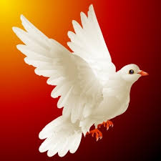
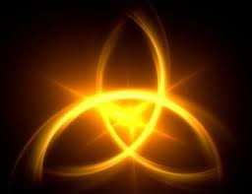
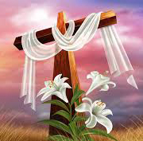
洗礼
Baptism

Slide 25
洗礼 Name
戴异桐 Sophia Milian | 戴婕 Vickey Milian
导师Mentor

Slide 26
快樂日 O Happy Day
快樂日,快樂日,救主洗淨我的罪孽
心裡清潔,極大歡喜
這日永遠不能忘記
快樂日,快樂日,救主洗淨我的罪孽
Happy day, happy day,
when Jesus washed my sins away. He taught me how to watch and pray,
and live rejoicing every day Happy day, happy day,
when Jesus washed my sins away.

Slide 27
洗礼Name
马珍妮 Jenny Ma | 王梅荣 Meirong Wang
导师Mentor

Slide 28
快樂日 O Happy Day
快樂日,快樂日,救主洗淨我的罪孽
心裡清潔,極大歡喜
這日永遠不能忘記
快樂日,快樂日,救主洗淨我的罪孽
Happy day, happy day,
when Jesus washed my sins away. He taught me how to watch and pray,
and live rejoicing every day Happy day, happy day,
when Jesus washed my sins away.

